Slide 1
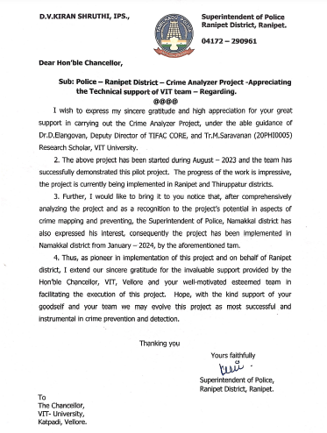
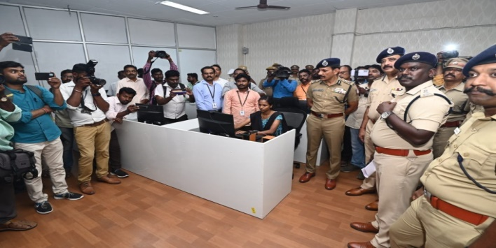
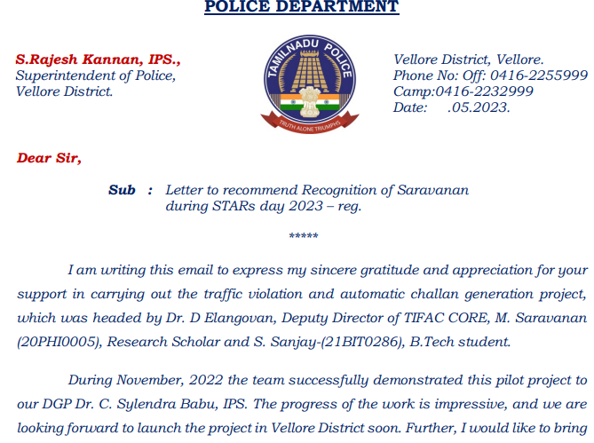
SOCIAL OUTREACH : 2024
In the month of Nov 2022, A pilot project on the traffic violation and automatic challan generation was demonstrated to DGP Dr. C. Sylendra Babu, IPS. He impressed with the work and looking forward to launch the project in Vellore District soon.
In the month of May 2023, A pilot project on crime pattern analysis and Traffic Violation for the Vellore district has been demonstrated to ADGP, Mr. K. Shankar, IPS. He appreciated and expressed his interest to implement that all over Tamilnadu.
Contact Details: Dr. D. Elangovan , Deputy Director & Professor , eangovan.devaraj@vit.ac.in

Slide 2
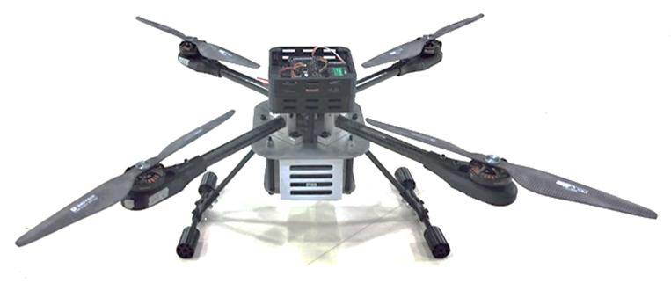
Development of GPS-Denied Autonomous Drone for Internal Environments : 2024
Abstract
This research focuses on the development of an autonomous drone capable of operating in GPS-denied indoor environments. By leveraging advanced sensor fusion techniques, including LiDAR, cameras, and inertial measurement units (IMUs), the drone can accurately perceive its surroundings and navigate autonomously. This technology has the potential to revolutionize various industries, such as: Industrial Inspection, Warehouse Automation, Search and Rescue, Agriculture etc. By enabling autonomous operations in GPS-denied environments, this technology paves the way for increased productivity, efficiency, and safety across numerous sectors.
Funded by :
Pedigri Technologies, UAE
( Consultancy Project)
Status:
On-going (Started: May 2024)
Outcomes :
Consultancy
Contact Details: Dr. Arjun Singh K
Assistant Professor Senior Grade I
arjunsingh.k@vit.ac.in

Slide 3
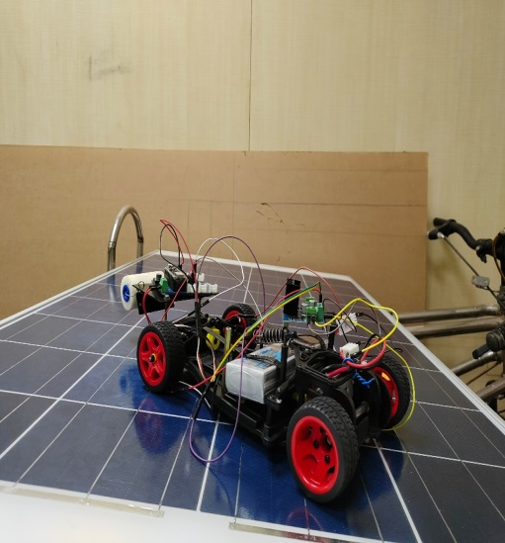
Smart PV Cleaning Robot : May 2024
Abstract
The Smart PV Cleaning Robot enhances the efficiency of photovoltaic solar panels by utilizing automated navigation and real-time environmental sensing. It detects dust and debris, adapting its cleaning strategy for optimal performance. With a compact design, it operates effectively on various installations while minimizing water usage and employing eco-friendly agents. This innovation reduces maintenance costs and downtime, supporting the broader adoption of solar technology for a sustainable future
Photo
Funded by : VIT consumables
Status:
On-going ( 2024- 2025)
Outcomes : Patent Granted - Automatic Cleaning Robot For PV Module- 411594-001
Contact Details: Dr. N. Kalaiselvan
Assistant Professor Senior Grade-2
kalaiselvan.n@vit.ac.in

Slide 4
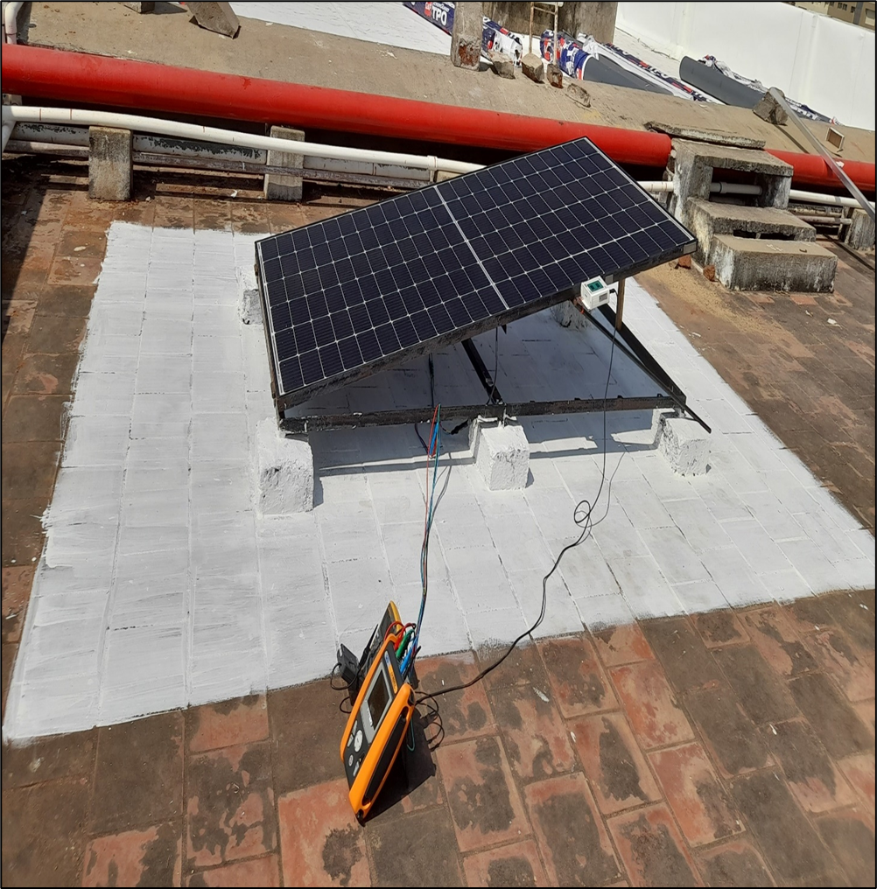
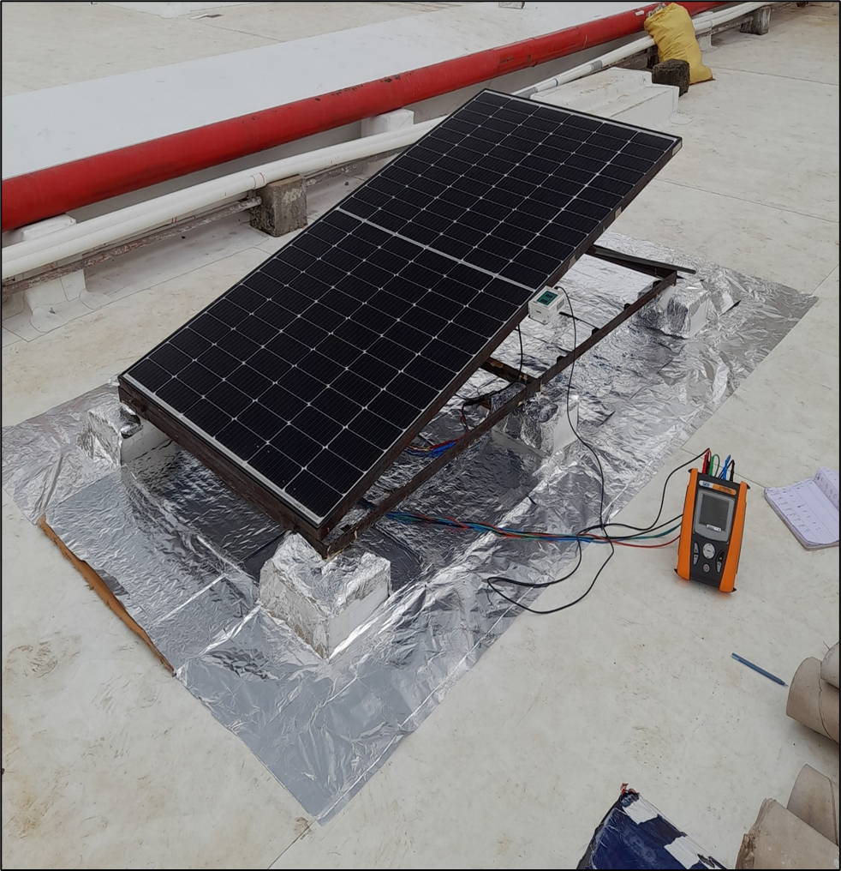
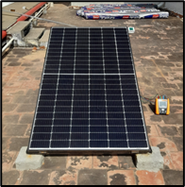
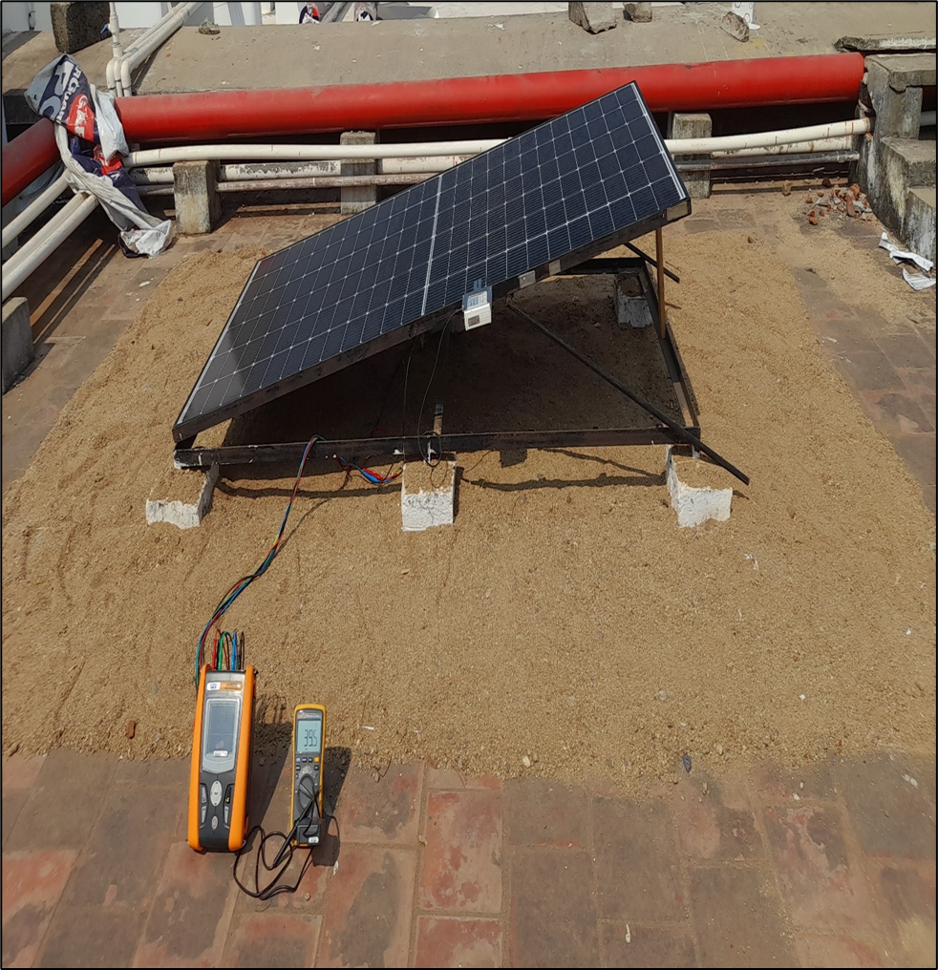
Performance analysis of Bifacial PV module at different tilt angle and albedo condition : 2024
Abstract
This research delves into the performance analysis of bifacial photovoltaic (PV) modules under varying tilt angles and albedo conditions. The study investigates the impact of these factors on energy generation, aiming to optimize system efficiency and maximize power output. Through rigorous experimentation and data analysis, the optimal tilt angle and ground surface characteristics for enhanced bifacial PV performance are explored. The findings of this study provide valuable insights for the deployment of bifacial PV systems in diverse environmental conditions, contributing to the advancement of renewable energy technologies.
Funded by :
VIT Research Fund
Status:
On-going ( 2024- 2025)
Outcomes :
1 publication in Applied Energy (I.F-10.1), Work featured in PV Magazine, USA.
Contact Details: Dr. Suprava Chakraborty
Associate Professor Grade-2
suprava.chakraborty@vit.ac.in

Slide 5
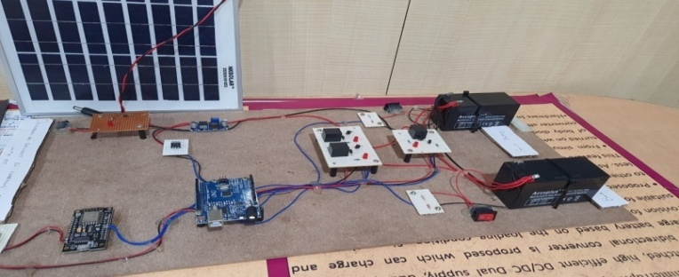
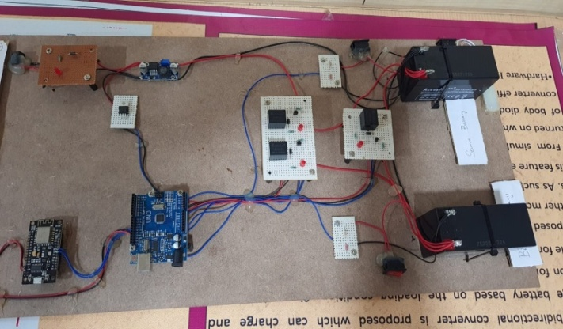
Active thermal management based Smart charge controller for EV application : 2024
Abstract
This research focuses on developing advanced thermal management and control strategies for Electric Vehicle (EV) charging systems. Key features include real-time thermal monitoring to prevent overheating, intelligent charging algorithms to maximize energy utilization, and adaptive control for seamless integration with grid-connected and standalone photovoltaic (PV) systems. These innovations contribute to the sustainable and efficient deployment of electric vehicles.
Photo
Funded by : VIT SEED FUND
Status:
On-going ( 2024- 2025)
Outcomes :
Patent Granted :Portable wind-solar powered EV charging station, 400576-001
Patent Filled: Renewable energy mounting system, 417596-001
Contact Details: Dr. Santanu Kumar Dash
Assistant Professor Senior Grade-2
santanukumar.dash@vit.ac.in

Slide 6
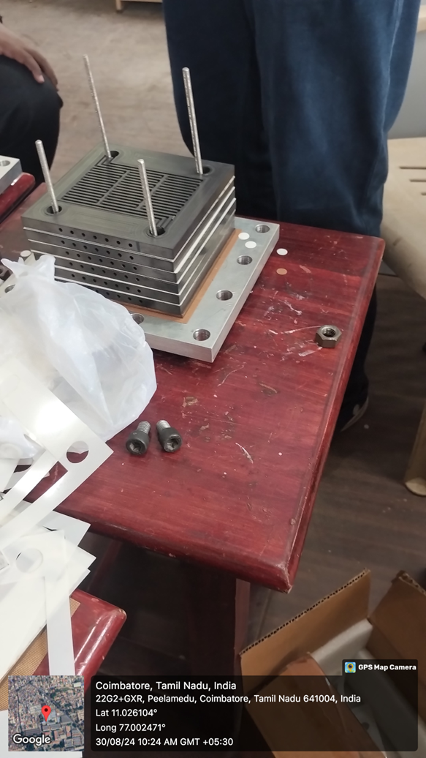
Fuel Cell Powered Electric Bicycles : 2024
Abstract
TIFAC CORE at VIT, Vellore, in collaboration with PSG Tech, Coimbatore, is working on an innovative project to power two- and three-wheelers using green hydrogen through the indigenous development of a 250W Proton Exchange Membrane Fuel Cell (PEMFC) stack. This pioneering initiative, set for completion by May 2025, represents a significant step toward sustainable transportation. The VIT team will focus on optimizing flow channels, conducting numerical simulations for the PEMFC stack, and developing converters and control systems. Prototype development is being guided by the expert team at PSG Tech, utilizing their extensive experience in fuel cell technology.
Photo
Funded by : VIT
Status:
On-going ( 2024- 2025)
Outcomes : Part of the work published in Scientific Report Journal, Product will be launched in May 2025
Contact Details: Dr. D. Elangovan
Deputy Director & Professor
elangovan.devaraj@vit.ac.in

Slide 7
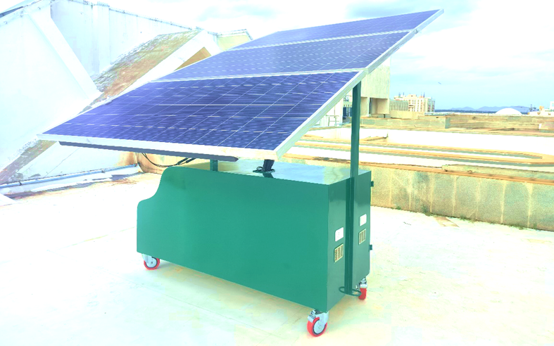
Design and Development of Portable Solar Power Station
Abstract
This research presents the development of a portable solar power station designed to provide reliable and sustainable power solutions for off-grid and on-the-go applications. The power station incorporates several innovative features, including a modular design with foldable solar panels and a novel single-axis automatic solar tracking system. The solar tracking system enhances the efficiency of the solar panels by optimizing their orientation towards the sun, even in low-light conditions. The power station seamlessly integrates solar power generation with battery storage, ensuring continuous power supply, irrespective of sunlight availability. By leveraging renewable energy sources, this technology offers a clean and environmentally friendly alternative to traditional power sources, contributing to a more sustainable future.
Funded by :
Pedigri Technologies, UAE
(Consultancy Project) VIT SEED Grant
Status:
On-going (July 2023 to Jun 2025)
Outcomes :
VIT, Arjun Singh K, Elangovan D, Thundil Karuppa Raj R, “Modular Portable Solar Power Station”, Intellectual Property India, Patent No.: 406099-001 (2024)
Contact Details: Dr. Arjun Singh K
Assistant Professor Senior Grade I
arjunsingh.k@vit.ac.in

Slide 8
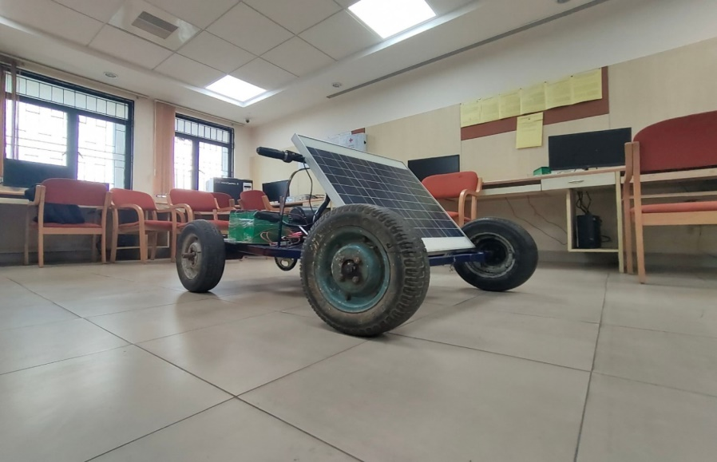
Solar-Powered Electric Vehicle(EV) for Sustainable Indoor Hospital Transportation
: February -2024
Abstract
This project focuses on developing a solar-powered electric vehicle (EV) designed for sustainable indoor transportation within hospital environments. By harnessing solar energy, the vehicle aims to reduce carbon emissions and energy consumption while providing an efficient, eco-friendly solution for transporting patients, staff, and medical supplies across hospital facilities. The integration of solar panels ensures that the EV can operate with minimal reliance on external power sources, promoting sustainability in healthcare settings. This innovation aligns with the growing need for green solutions in hospitals, enhancing both operational efficiency and environmental responsibility.
Funded by :
E-Cell, Faculty Startup Venture-2024
Status:
On-going ( 2024- 2025)
Outcomes :
Patent Granted - Solar Powered Autonomous Electric Vehicle- 414045-001
Contact Details: Dr. N. Kalaiselvan
Assistant Professor Senior Grade-2
kalaiselvan.n@vit.ac.in

Slide 9
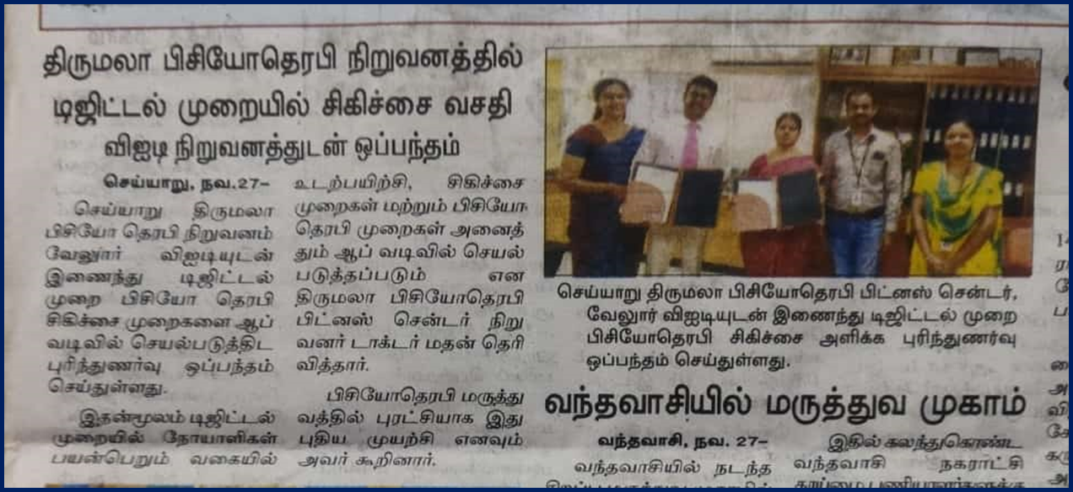
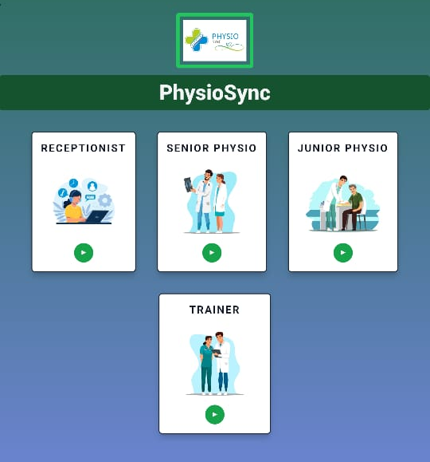
Software Development for Hospital Management System : 2024
Photo
Funded by : Sri Thirumala Physiotherapy and Pain Relief Clinic, Tamilnadu
Status:
Completed
Outcomes : This project, conducted in partnership with Sri Thirumala Physiotherapy and Pain Relief Clinic, included an MoU granting VIT a 10% royalty on software sales, showcasing our software expertise and creating a new revenue stream for the research center.
Contact Details: Dr. D. Elangovan
Deputy Director & Professor
elangovan.devaraj@vit.ac.in

Slide 10
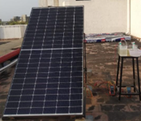
Solar powered green Hydrogen generation : 2024
Abstract
This research explores the potential of solar-powered green hydrogen generation as a sustainable and clean energy solution. By harnessing solar energy to power the electrolysis process, water is split into hydrogen and oxygen, producing green hydrogen with zero carbon emissions. The study investigates the techno-economic feasibility of solar-powered hydrogen generation systems, considering factors such as solar irradiance, electrolyzer efficiency, and hydrogen storage and transportation. The potential applications of green hydrogen, including its use in fuel cell vehicles, power generation, and industrial processes, are also discussed. This research aims to contribute to the development of a sustainable and low-carbon energy future.
Funded by :
VIT Research Fund
Status:
On-going ( 2023- 2025)
Outcomes :
In process of publication.
Contact Details: Dr. Suprava Chakraborty
Associate Professor Grade-2
suprava.chakraborty@vit.ac.in

Slide 11
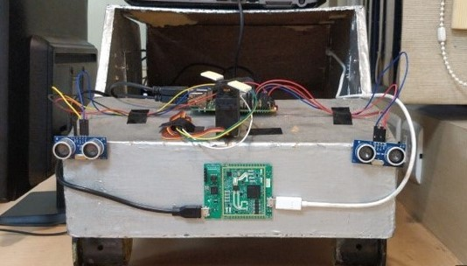
Integrated sensing and control system for enhanced autonomous vehicle : 2023
Abstract
This research focuses on using a combination of sensors, including radar and ultrasonic systems, to accurately measure distances and speeds of objects for autonomous driving. Radar, a crucial sensor for autonomous vehicles, detects and tracks objects like cars, pedestrians, and obstacles to create precise paths. The prototype has been developed in the laboratory and tested under laboratory conditions for experiencing the highly efficient autonomous operation of the vehicle.
Photo
Funded by : VIT Consumables
Status:
Completed ( 2023)
Outcomes :
Paper Under review in International Journal
Contact Details: Dr. Santanu Kumar Dash
Assistant Professor Senior Grade-2
santanukumar.dash@vit.ac.in

Slide 12
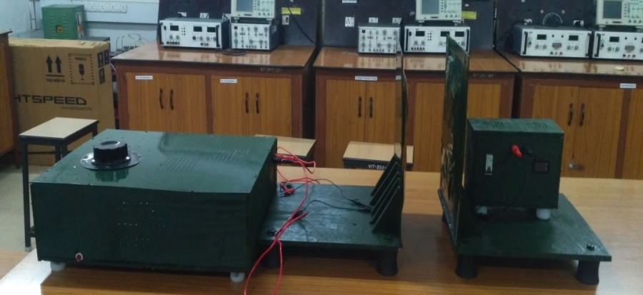
Universal Hybrid Wireless Fast Charger For Two/Three wheeled Electric Vehicles : 2023
Abstract
Wireless Power Transmission (WPT) has gained global research interest, but challenges like coil misalignment and varying battery voltage levels have limited efficient power transfer. To address these, a research team developed a universal hybrid (Grid-Renewable) EV wireless charger with remarkable efficiency. This new prototype successfully charges lithium-ion batteries of 12V, 24V, 36V, and 48V across a 1-meter range with 75% efficiency—surpassing known systems. It demonstrated excellent performance under horizontal and angular misalignment tests, delivering regulated output. Without the need for a storage battery at the station, this compact system can be deployed anywhere with sufficient power sources
Photo
Funded by : VIT SEED GRANT
Status:
Completed
Outcomes : Applied for funding to support further scale-up.
Contact Details: Dr. D. Elangovan
Deputy Director & Professor
elangovan.devaraj@vit.ac.in

Slide 13
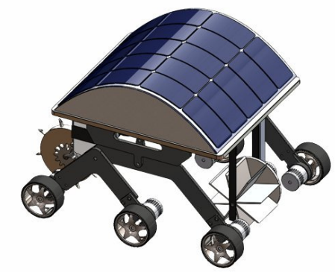
Unmanned solar PV Powered multipurpose Agri rover : 2023
Abstract
This research presents the development of an unmanned solar-powered multipurpose agri-rover designed to enhance agricultural operations and monitoring. The rover is equipped with various sensors, including cameras, soil moisture sensors, and GPS, to collect real-time data on crop health, soil conditions, and environmental parameters. The solar-powered system ensures autonomous operation, reducing reliance on manual labor and minimizing environmental impact. Equipped with advanced sensors and AI capabilities, the rover can autonomously navigate fields, collect real-time data on soil moisture, nutrient levels, and crop health. By leveraging solar energy, the rover minimizes reliance on fossil fuels and reduces operational costs.
Funded by :
VIT Seed Grant
Status:
Completed ( 2021- 2023)
Outcomes :
Design patent granted (Patent no. 399183), Utility patent published (Application Number -202441003805), 1 Research paper Publication
Contact Details: Dr. Suprava Chakraborty
Associate Professor Grade-2
suprava.chakraborty@vit.ac.in

Slide 14
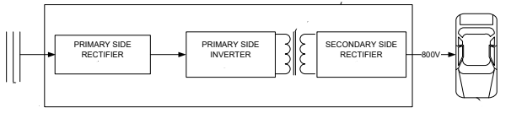
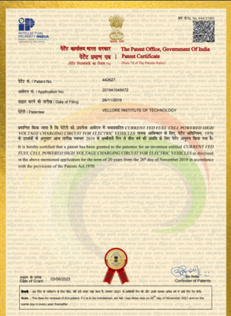
Current Fed Fuel Cell Powered High Voltage Charging Circuit For Electric Vehicles : 2023
Abstract
This fuel-cell-powered high-voltage (800V) charging system for electric vehicles achieves substantial voltage gain through an optimized voltage multiplier and minimal capacitor selection. The system efficiently raises voltage from 21V/41V to 800V, increasing power density with carefully chosen capacitors. Integrating a current source inverter (CSI) enhances efficiency and power density, while snubber-less soft switching reduces switching losses without extra components. A transformer with a low turns ratio of 4 contributes to high DC-DC voltage gain. This optimized design resolves issues with reverse current and current ripple seen in conventional chargers, eliminating the need for reverse-blocking diodes through the CSI topology.
Photo
Funded by : VIT SEED GRANT
Status:
Completed
Outcomes : Patent Granted Patent No: 442627 , Date : 03/08/2023
Contact Details: Dr. D. Elangovan
Deputy Director & Professor
elangovan.devaraj@vit.ac.in

Slide 15
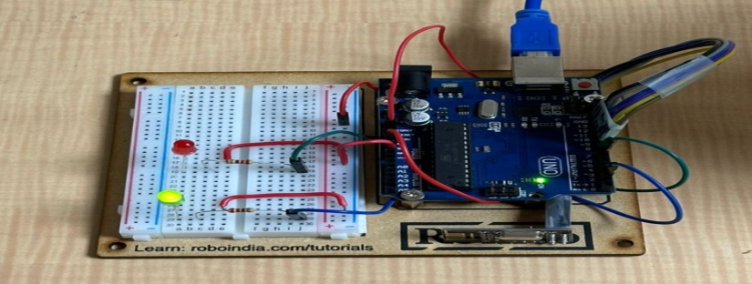
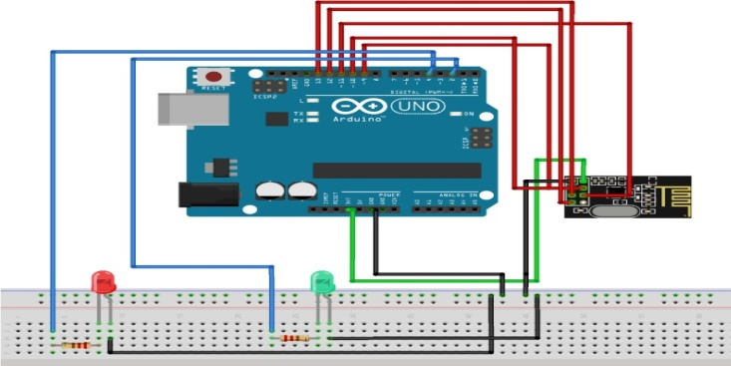
Automated curved road vehicle detection : 2023
Abstract
The escalating threat of avenue injuries in India necessitates modern answers to enhance street protection. While a great portion of injuries (67%) occur on straight roads, incidents on curved, pothole-ridden, and steep-grade roads together contribute to only 13.8% of the overall injuries. Sharp curves on hilly roads create blind spots, difficult drivers to assess oncoming motors appropriately. V2I sensors seize infrastructure statistics, presenting actual-time advisories on road situations, site visitors, accidents, production zones, and parking availability. This research delves into the fusion of price effective V2I generation with ADAS, providing an revolutionary technique to curtail accidents on curved and hilly roads.
Funded by :
VIT Consumables-2023
Status:
Completed (2023)
Outcomes :
Paper Under review in International Journal
Contact Details: Dr. N. Kalaiselvan
Assistant Professor Senior Grade-2
kalaiselvan.n@vit.ac.in

Slide 16
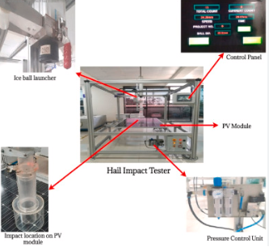
Analysis of the hail impacts on the performance of commercially available photovoltaic modules : 2023
Abstract
This study investigates the impact of hailstorms on the performance of commercially available photovoltaic (PV) modules. Hailstones, varying in size and velocity, can cause significant damage to PV modules, leading to reduced energy output and increased maintenance costs. To assess the severity of hail damage, a series of hail impact tests were conducted on PV modules, simulating real-world conditions. The electrical performance, structural integrity, and visual appearance of the modules were evaluated before and after each hail impact. The study analyzes the impact of hail on key performance parameters such as open-circuit voltage, short-circuit current, fill factor, and maximum power output.
Funded by :
With Industry ( Waaree Energies Ltd ) collaboration
Status:
On-going ( 2021- 2025)
Outcomes :
1 publication in Renewable Energy, Work featured in PV Magazine, USA
Contact Details: Dr. Suprava Chakraborty
Associate Professor Grade-2
suprava.chakraborty@vit.ac.in

Slide 17
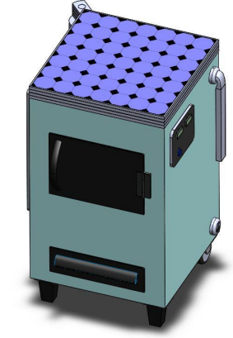
Portable solar powered medical incinerator : 2023
Abstract
This research presents the design and development of a portable solar-powered medical incinerator. The incinerator is designed to safely and efficiently dispose of medical waste, particularly in remote areas with limited access to electricity. The system utilizes solar energy to power the incineration process, reducing reliance on fossil fuels and minimizing greenhouse gas emissions. The incinerator is equipped with a temperature control system to ensure complete combustion of medical waste, preventing the spread of diseases. Additionally, the portable design allows for easy transportation and deployment in various healthcare settings. This innovative solution addresses the critical need for safe and sustainable medical waste disposal, especially in resource-constrained regions.
Funded by :
VIT Research Fund
Status:
Completed (2022-2024)
Outcomes :
Design patent granted (Patent no. 389014)
Contact Details: Dr. Suprava Chakraborty
Associate Professor Grade-2
suprava.chakraborty@vit.ac.in

Slide 18
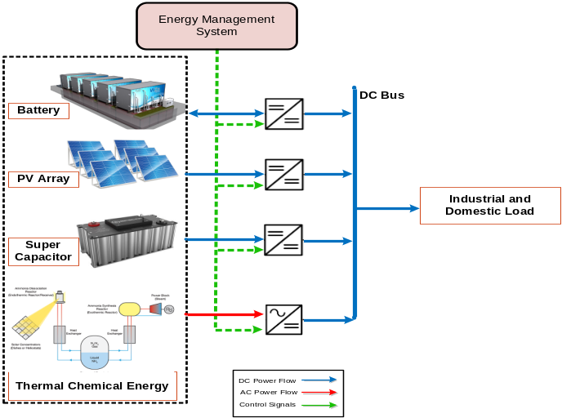
Smart Energy Management of DC-Microgrid : 2022-2023
Abstract
This research focus on Development of artificial intelligence based energy management for Microgrid. Development of an adaptive controller for the power conditioning in the Microgrid. Analyzing the performance of artificial intelligence based controllers for the considered microgrid system including Solar PV, supercapacitor, battery energy storage and thermo chemical energy.
Photo
Funded by : VIN International Research Fund
Status:
Completed ( 2023)
Outcomes:
MOU Signed between VIT and Walailak University , Adjunct Professor Dr. Kamon Thinsurat, Walailak University, visited VIT Vellore Campus,
Joint Paper and research Proposal submitted
Contact Details: Dr. Santanu Kumar Dash
Assistant Professor Senior Grade-2
santanukumar.dash@vit.ac.in

Slide 19
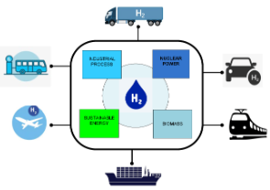
Hydrogen Fuel for Future Mobility : 2022
Abstract
Hydrogen, a clean and versatile energy carrier, is emerging as a promising solution for sustainable transportation. This research explores the potential of hydrogen fuel cell vehicles (FCVs) as a zero-emission alternative to traditional fossil fuel-powered vehicles. The study investigates the technical feasibility, economic viability, and environmental benefits of hydrogen fuel cell technology. Challenges such as hydrogen production, storage, and distribution are discussed, along with potential solutions and future advancements. The integration of hydrogen fuel cell vehicles into existing transportation infrastructure and the development of a hydrogen fueling network are also explored.
Funded by :
VIT Research Fund
Status:
Ongoing (2021-2026)
Outcomes :
4 research publications
Contact Details: Dr. Suprava Chakraborty
Associate Professor Grade-2
suprava.chakraborty@vit.ac.in

Slide 20
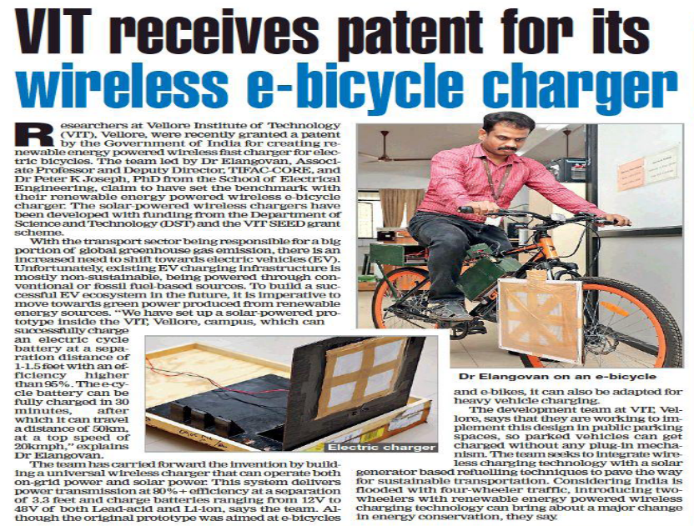
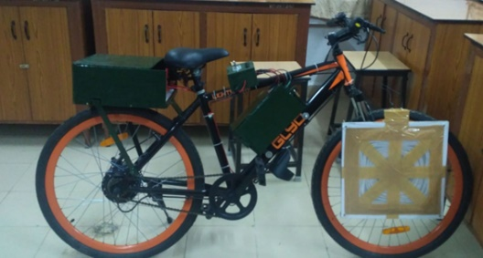
Renewable Energy Powered Wireless Fast Charger For Electric Bicycle : 2021
Photo
Highlights:
Efficiency : 94.32%
Coupling separation of 20cm. (Upto 40 cm)
Misalignment : 15°
Funded by : VIT SEED GRNAT
Status:
Completed
Outcomes : Patent Granted. Patent No: 364892, Date : 3.04.2021, Published in Applied Energy (I.F.-10.1) and IEEE System Journal.
Contact Details: Dr. D. Elangovan
Deputy Director & Professor
elangovan.devaraj@vit.ac.in

